Slide 1

TEAM - 01
PROJECT
Air Flight Delay Prediction
Business Objective
Flight delays cost the industry an estimated $25 billion every year . The bill for
assengers an extra 25$ per hour and an extra 62$ per minute for carriers
Objective
The objective of the analysis is to Predict which flights would be delayed and by
how long?

Slide 2
TEAM - 01
Exploratory Data Analysis
Importing the Data set of 31 variables and 58,19,079 observations
Understanding of Variables in the Data set
Data set Analysis with Tableau
Data Analysis and Exploration in R- Studio

Slide 3
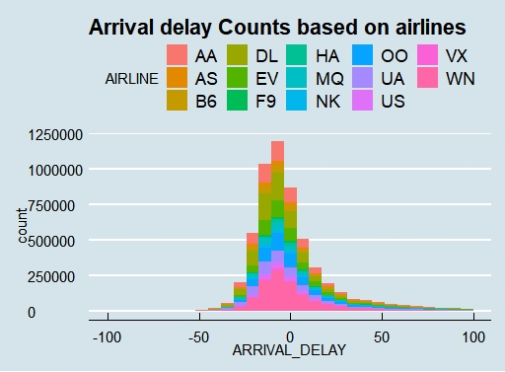
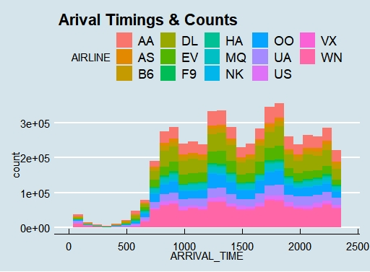
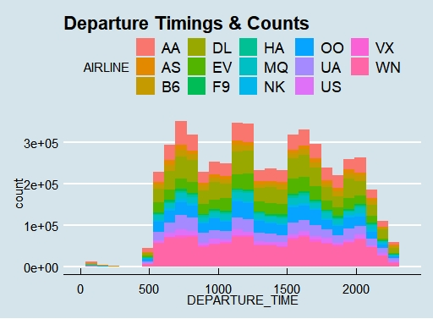
Histograms
Gives insights about Range of the Timings and the counts with respect to Timings of the Airlines.

Slide 4
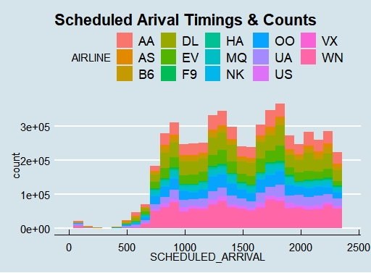
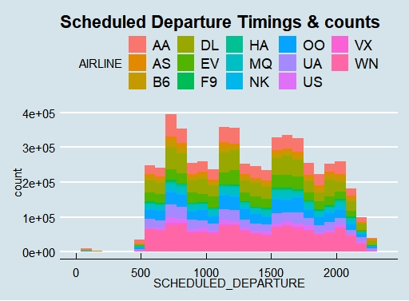
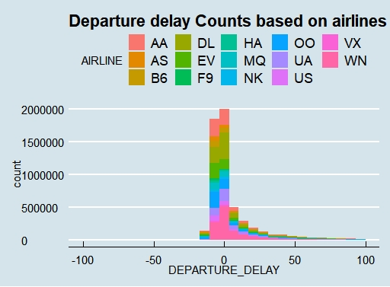
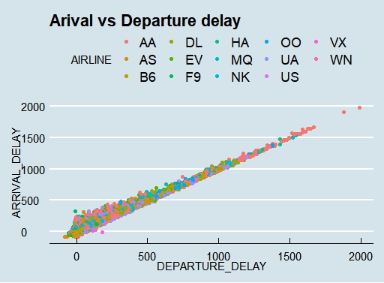

Slide 5
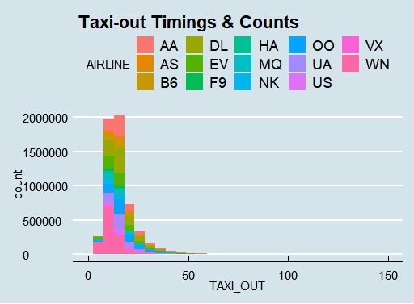
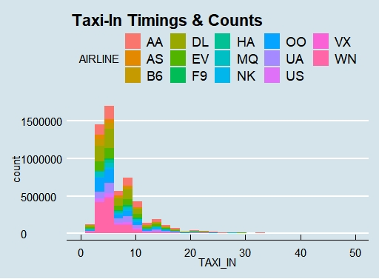

Slide 6
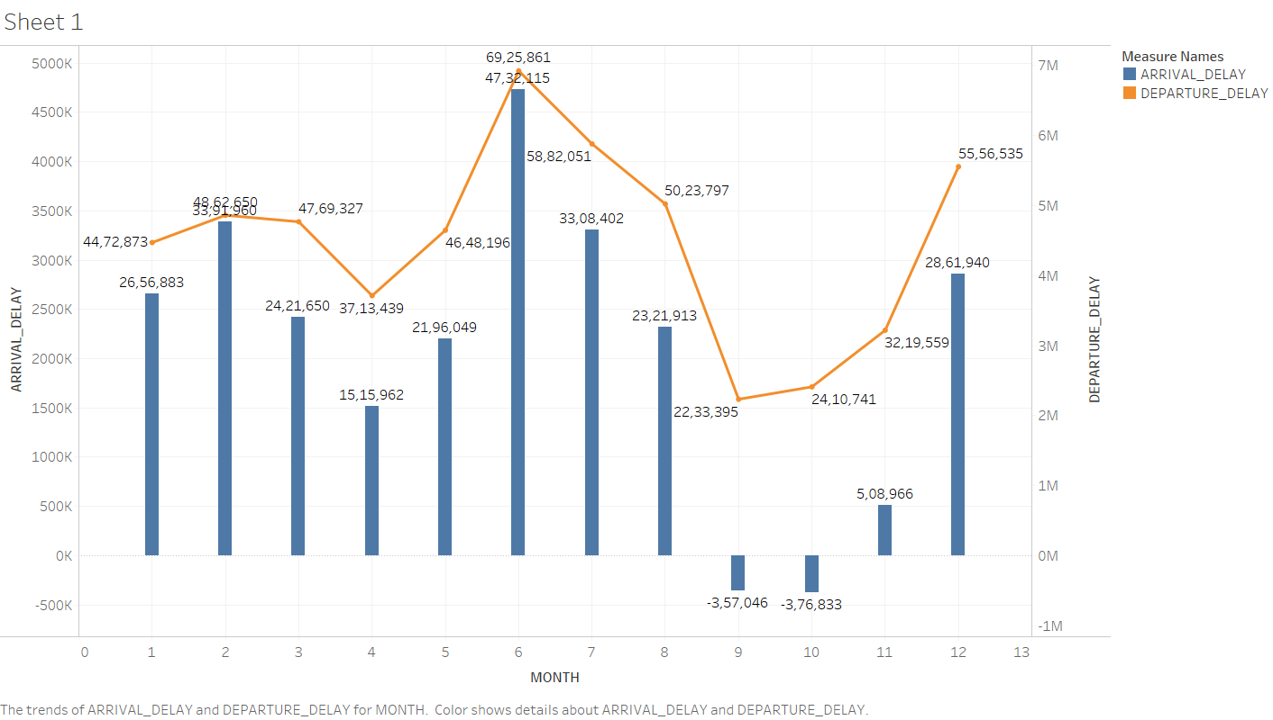
Month with the Maximum delay is 6th Month i.e. June

Slide 7
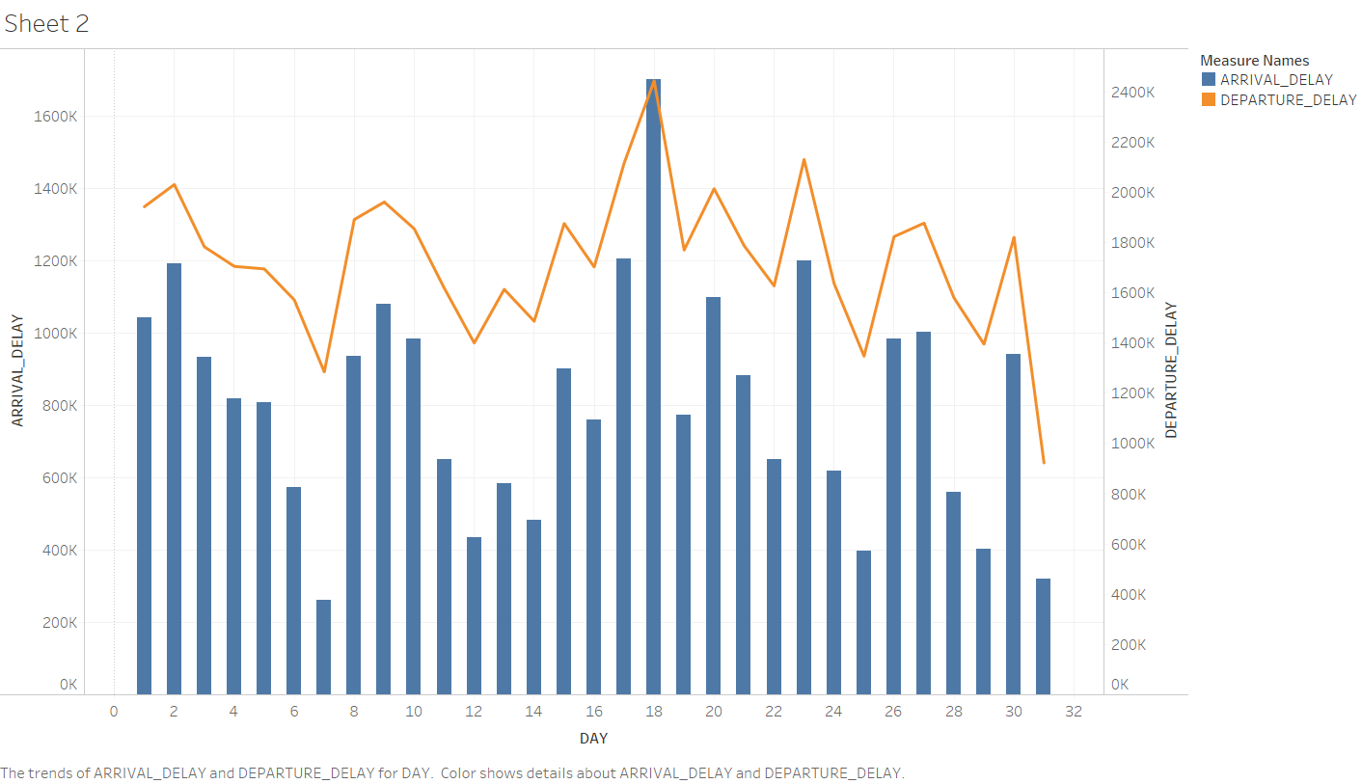
Day of the Month with the Maximum delay is 18th day of the Month

Slide 8
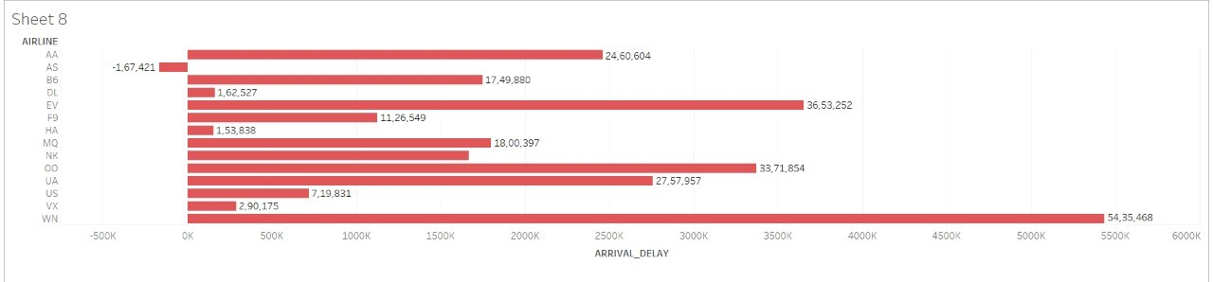
Arrival Delay based on Airlines

Slide 9
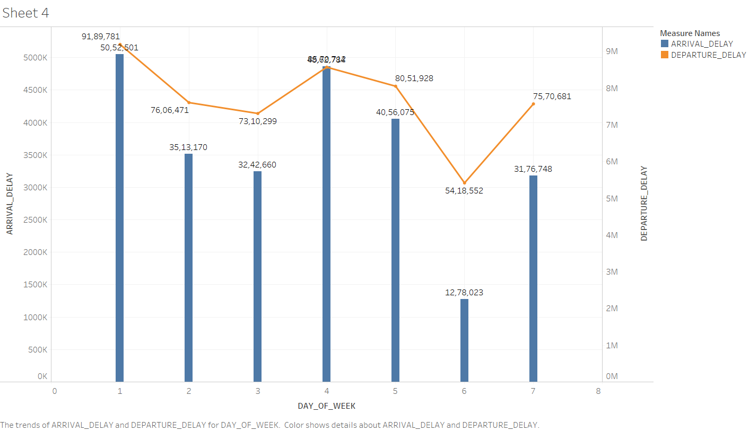
Day of the Week with the Maximum delay is 1st Day i.e. Monday

Slide 10
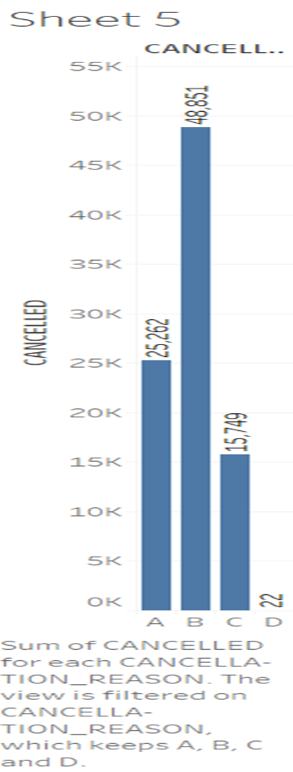
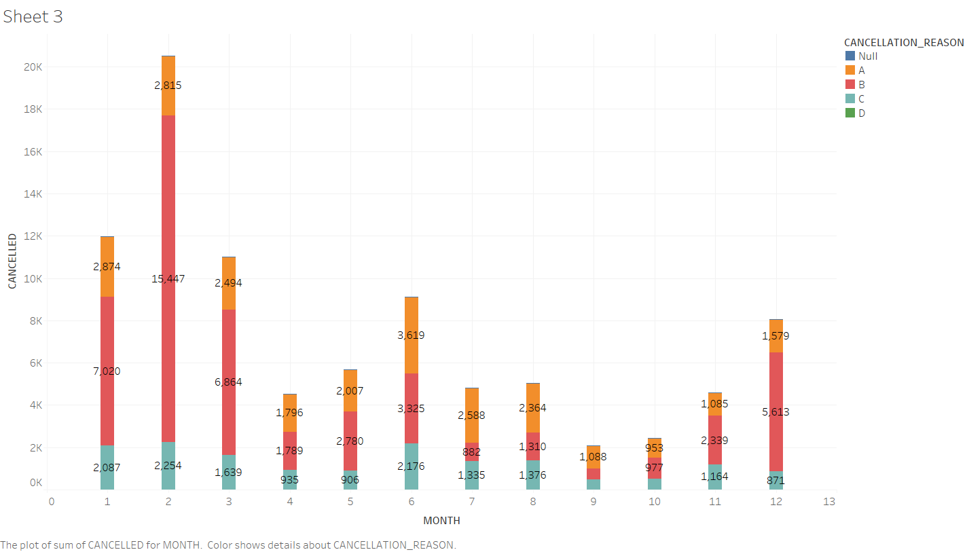
Cancellation of the Flights
Maximum no of the flights are cancelled due to the reason B i.e. Weather.
Maximum Cancellations are seen in the month of February.

Slide 11
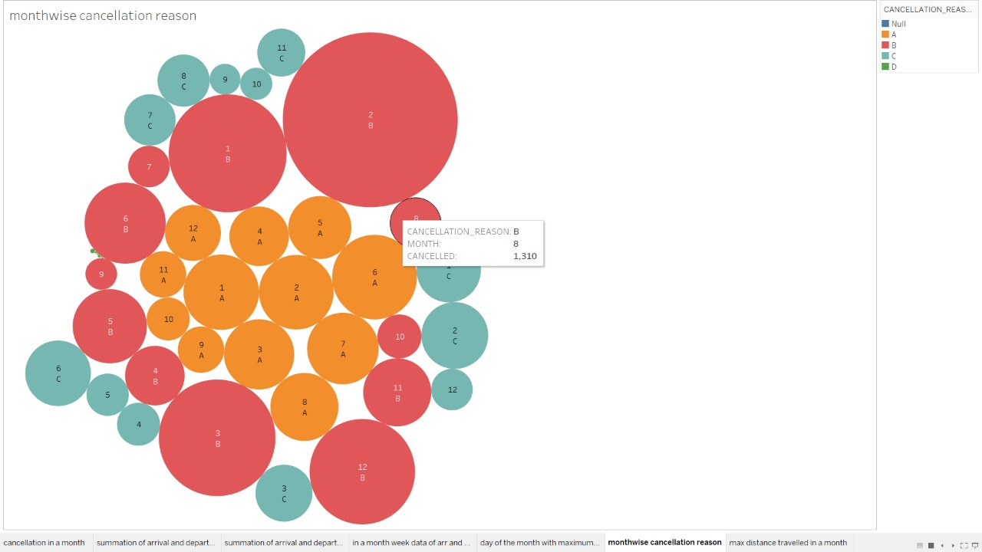

Slide 12
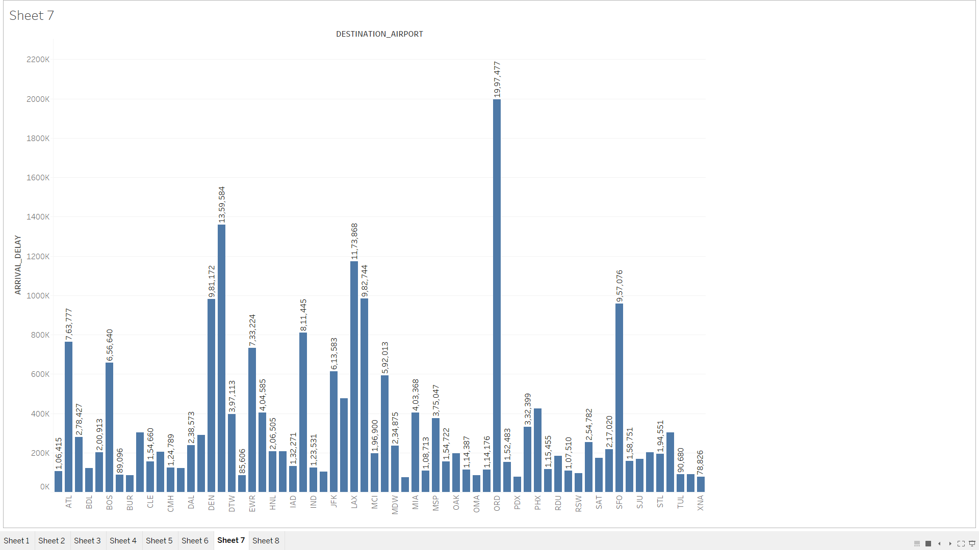
Destination Airports with the maximum Arrival Delay

Slide 13
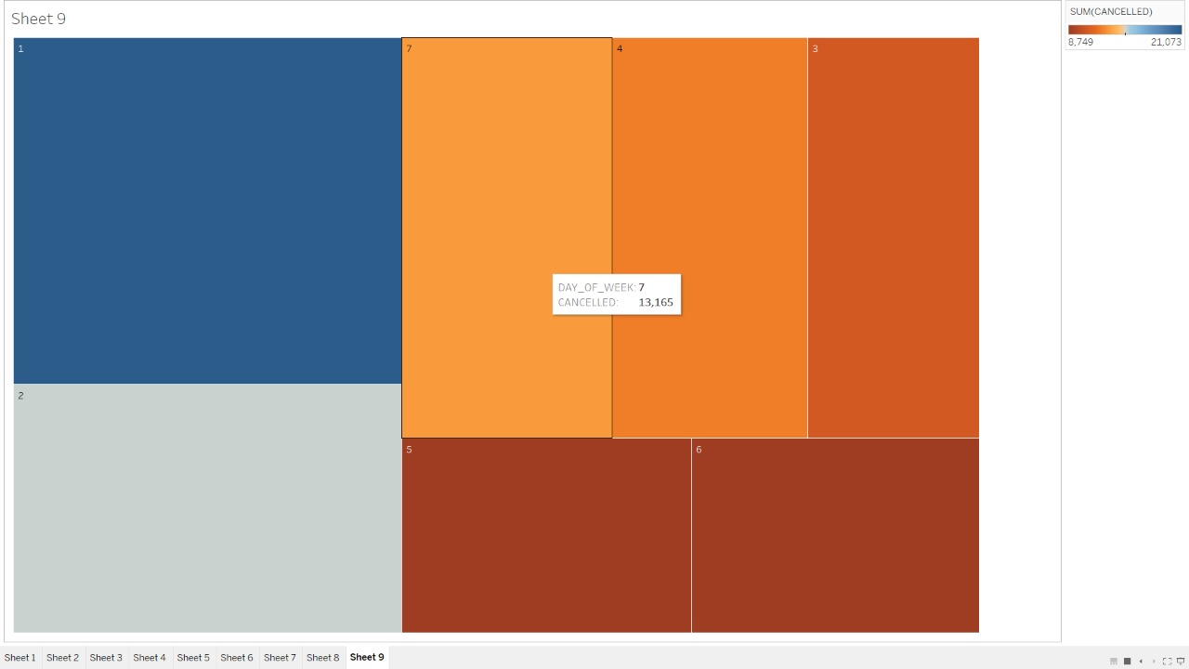
Day of the Week with the cancellation distribution

Slide 14
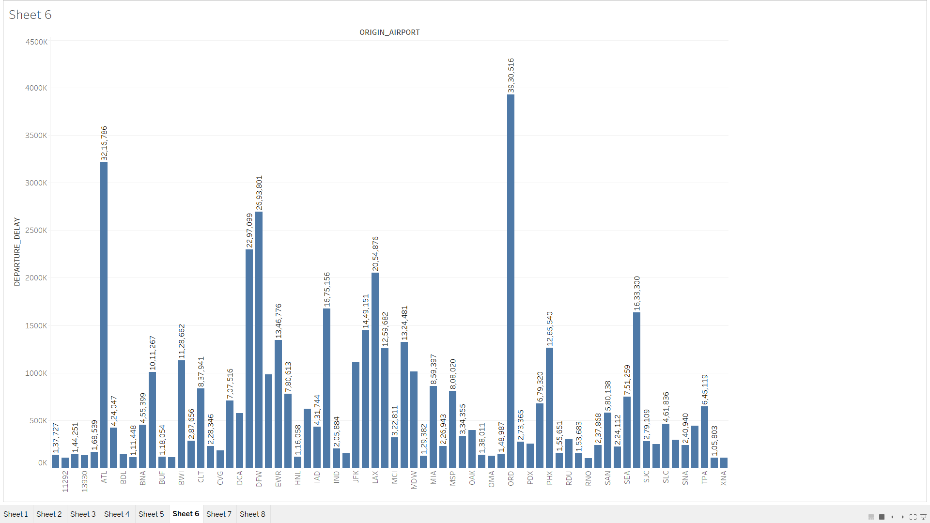
Origin Airports with the maximum Departure Delay

